Slide 1
Making Decisions under Uncertainty

Slide 2
Agenda
Introduction to decisions under Uncertainty
Uncertainty
Decision trees
Dynamic decision making
Simulation
Revisiting Portfolio Optimization

Slide 3
New Ingredient
So far we mostly looked at decisions without uncertainty
Decisions
Objectives
Constraints
Now we introduce uncertainty
We now have to consider the chances that we are taking when making certain decisions

Slide 4
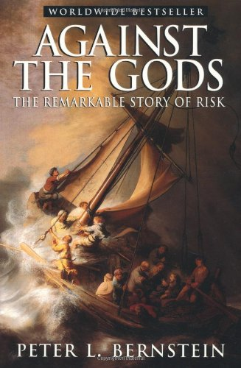
Against the Gods

Slide 5
Uncertainty
Decisions must be made before uncertainty is resolved
Portfolio decisions
Launching new products
Expanding into new markets
Uncertainty is usually modeled through a probability distribution

Slide 6
Uncertainty
Which decision to take will depend on the belief the decision maker, i.e., you, have about the likelihood of each possible “State of Nature”

Slide 7
Decision Making Under Uncertainty
A useful tool to help make decision under uncertainty is the decision tree
A decision tree is a graph representation of possible events
Decision ➔ Chance ➔ … ➔ Decision ➔ Chance …➔ Final Outcome
We need a tool to evaluate “lotteries”
Any thought?

Slide 8
Expected Value
The expected value for an uncertain alternative is calculated by multiplying each possible outcome of the uncertain alternative by its probability, and summing the results.
The expected value decision criterion selects the alternative that has the best expected value. In situations involving profits where “more is better,” the alternative with the highest expected value is best, and in situations involving costs, where “less is better,” the alternative with the lowest expected value is best.
Expected Profit; Expected Utility

Slide 9
Ingredients of a Tree
Structure
Decision nodes 
Chance nodes 
Data
Intermediate payoffs (costs and benefits) on any branch
Probabilities on chance branches only
Final cumulative payoffs at terminal points
Algorithm (“Dynamic Optimization”)
Start at the last stage
For each chance node, calculate the EV
For each decision node, select the branch with best EV, ignore others
Roll back to preceding decision stage, reiterate (2) and (3)
Notes:
From Ph. Delquie

Slide 10
Promotion or Not
A customer enters your store
You don’t know the type of the customer
With equal chance, the customer is willing to either pay $20 or $10, with equal chance.
Your price is $15 (0 costs), but the customer asks for a deeply discounted price of $5 (the price is $5)
You don’t know whether the customer has a value $20 or $10
What would you do?

Slide 11
What is the Tree (and the decision)?

Slide 12
Sensitivity Analysis
At which point do you give the discounted price to the customer?

Slide 13
Product Decision
To absorb some short-term excess production capacity at its Arizona plant, Special Instrument Products is considering a short manufacturing run for either of two new products, a temperature sensor or a pressure sensor. The market for each product is known if the products can be successfully developed. However, there is some chance that it will not be possible to successfully develop them.
Revenue of $1,000,000 would be realized from selling the temperature sensor and revenue of $400,000 would be realized from selling the pressure sensor. Both of these amounts are net of production cost but do not include development cost. If development is unsuccessful for a product, then there will be no sales, and the development cost will be totally lost. Development cost would be $100,000 for the temperature sensor and $10,000 for the pressure sensor.
Assume probability of development success for temperature tensor is 50% and for the other product it’s 80%

Slide 14
What is the Tree (and the decision)?

Slide 15
Value and Limitation of Decision Trees
Advantages
Wide applicability
Enhance/promote clarity of problem framing
Facilitate strategic, multi-stage thinking
Focus attention on terminal (not intermediate consequences)
Facilitate evaluation of information
Limitations
Discrete representation of decisions and uncertainties
Multiplication of branches

Slide 16
Competitive Reactions I
Consider a market with an incumbent
The new entrant has to decide to enter (or not)
The incumbent has to decide whether to retaliate (or not)
Firms have symmetric cost structures
Fixed cost = $1,750,000
Variable Cost= $30
If there is no entry, the incumbent sales 900,000 units at $50 per unit
If there is entry, the new entrant get 250,000 units from the incumbent sales
If the incumbent accommodate the entry, the market price will be at $45 per unit
If the incumbent retaliate against the entry, the market price will be at $35 per unit

Slide 17
What is the Tree (and the decisions)?

Slide 18
Competitive Reactions II
Consider a market with an incumbent
The new entrant has to decide to enter (or not)
The incumbent has to decide whether to retaliate (or not)
Firms have asymmetric cost structures
Fixed cost = $1,750,000
Variable cost incumbent= $30;
Variable cost new entrant= $20 with 50% chance and $40 with 50%
If there is no entry, the incumbent sales 900,000 units at $50 per unit
If there is entry, the new entrant get 250,000 units from the incumbent sales
If the incumbent accommodate the entry, the market price will be at $45 per unit
If the incumbent retaliate against the entry, the market price will be at $35 per unit

Slide 19
What is the Tree (and the decisions)?

Slide 20
Value of Information
How much would you be willing to pay to know the cost structure of your competitor?
Information is valuable only to the extent it influences decision making
Value of Information = The Increase in Expected Value from having information over not having it
Real information is often incomplete, unreliable

Slide 21
Markets for Information
We are often willing to pay for
Investment advice
Management consultants
Geological tests
Market research
Palm reading
Experiments
…
Information for a decision in the future
To invest in a particular stock
To restructure the organization
Mining
To introduce a new technology
Getting married
A/B Testing
…

Slide 22
Value of Information
Expected Value of Imperfect Information
EVII
=
EV with costless Imperfect Information
–
best EV without the Information

Slide 23
Market Research
MSBA Co. developed a new line of products. Management must decide on marketing and product strategy. Three options are considered, i.e., A (aggressive), B (basic) and C (cautious). The market conditions can be strong (S) or weak (W), with probabilities 45% and 55%, respectively
Based on the payoff table below, what is the best strategy?
Notes:
From Cornuejols and Trick, 1998.

Slide 24
Decision Tree

Slide 25
Market Research
Top management can buy a market research study for $500,000 which will reveal encouraging (E) or discouraging (D) news. In the past, when market ended up being strong, such studies were encouraging 60% of the time and discouraging 40% of the time. Whereas, when market ended up being weak, these studies were discouraging 70% of the time and encouraging 30% of the time.
Should management request the market research?

Slide 26
Some Probability

Slide 27
Bayesian Updating
The market research provides information that should help me update my prior about the probabilities of the market conditions

Slide 28
We can solve the tree
Should you buy the information?

Slide 29
Accounting for Risk
The expected value criterion does not take into risk (or variance of possible outcomes)
We need to a risk adjusted “value” for different lotteries, something called “Certainty equivalent”, which is derived from a utility function

Slide 30
Risk Profile
Most people are risk averse
Most people prefer of a safe outcome over a risk one
What would you do?
Safe Jobs | Risky Job | Frequency
$100,000 | $40,000 with probability ½ $160,000 with probability ½
$90,000 | $40,000 with probability ½ $160,000 with probability ½
$80,000 | $40,000 with probability ½ $160,000 with probability ½
$70,000 | $40,000 with probability ½ $160,000 with probability ½
Notes:
Source: wikipedia

Slide 31
Revisiting Portfolio Optimization
We considered five stocks
Amazon
Apple
eBay
Facebook
Google

Slide 32
Revisiting Portfolio Optimization

Slide 33
Value of the Portfolio

Slide 34
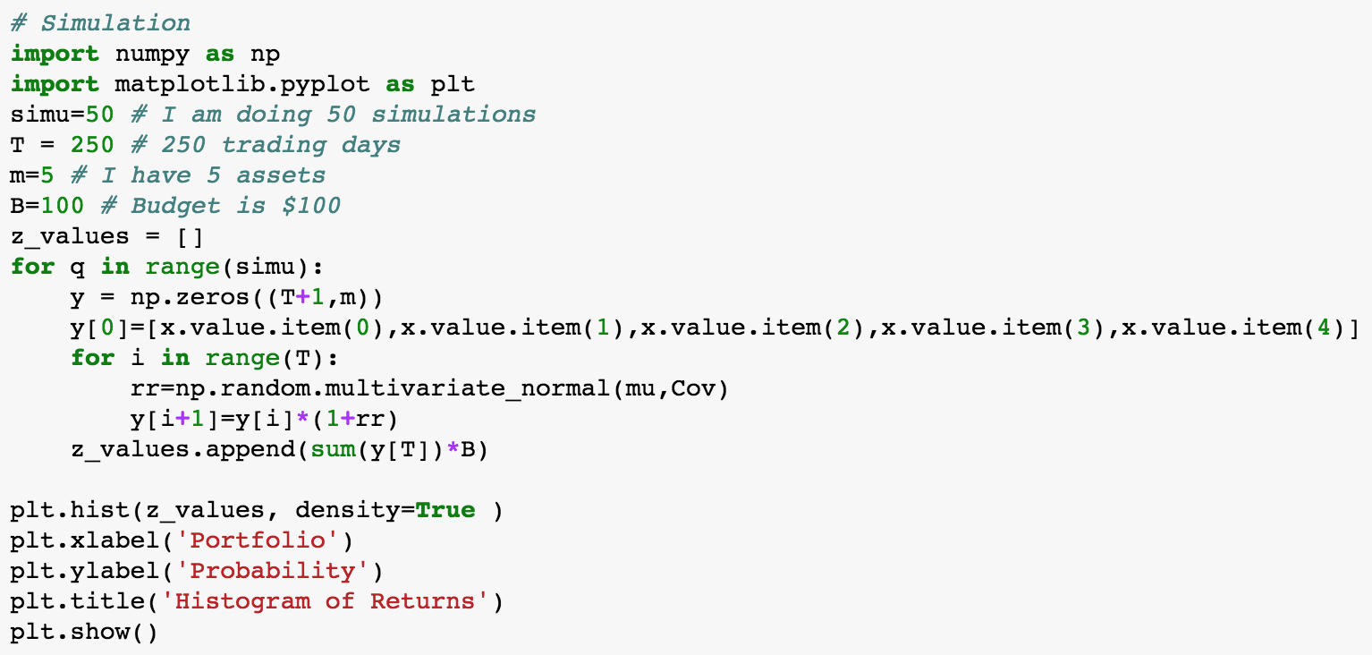
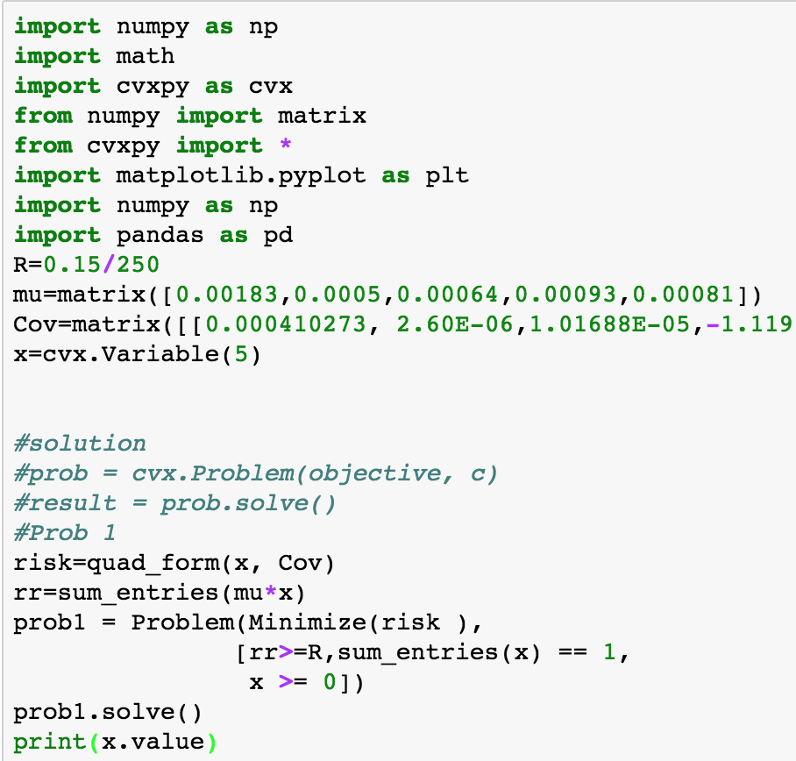
Simulation

Slide 35
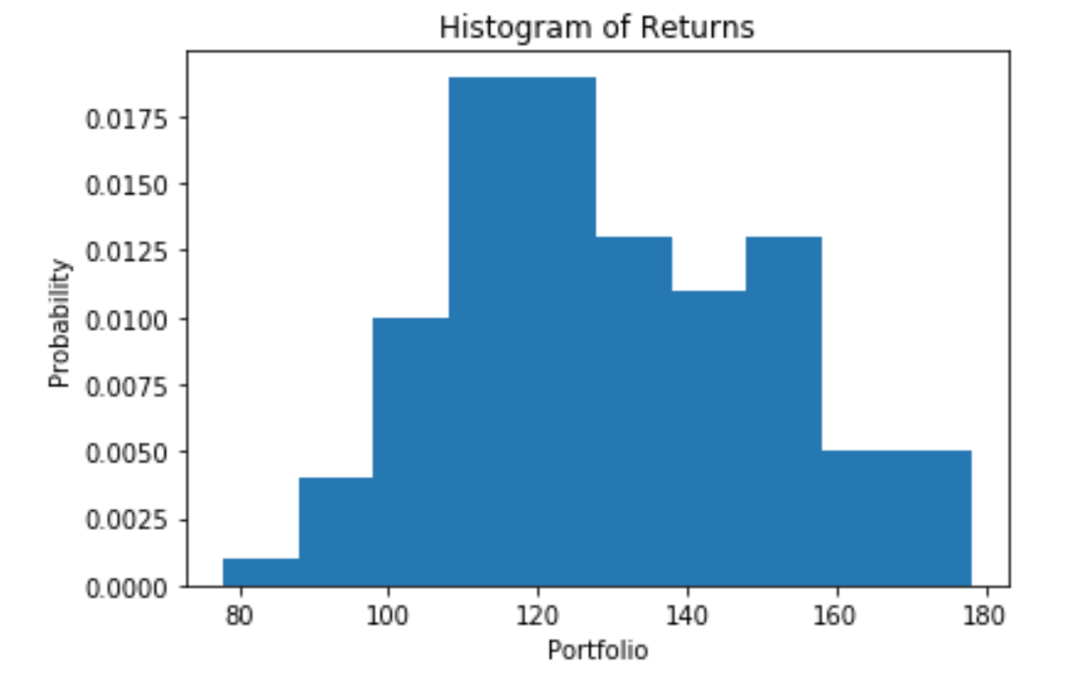
Histogram

Slide 36
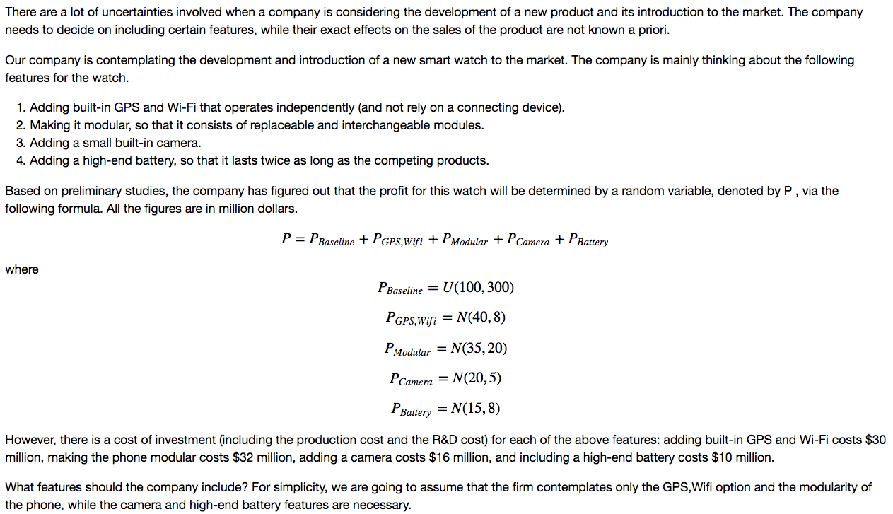
NPD Simulation

Slide 37
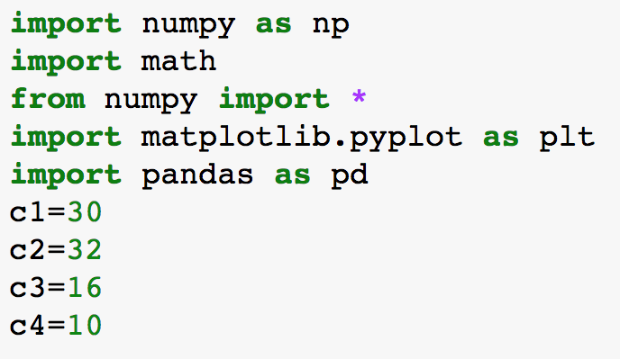
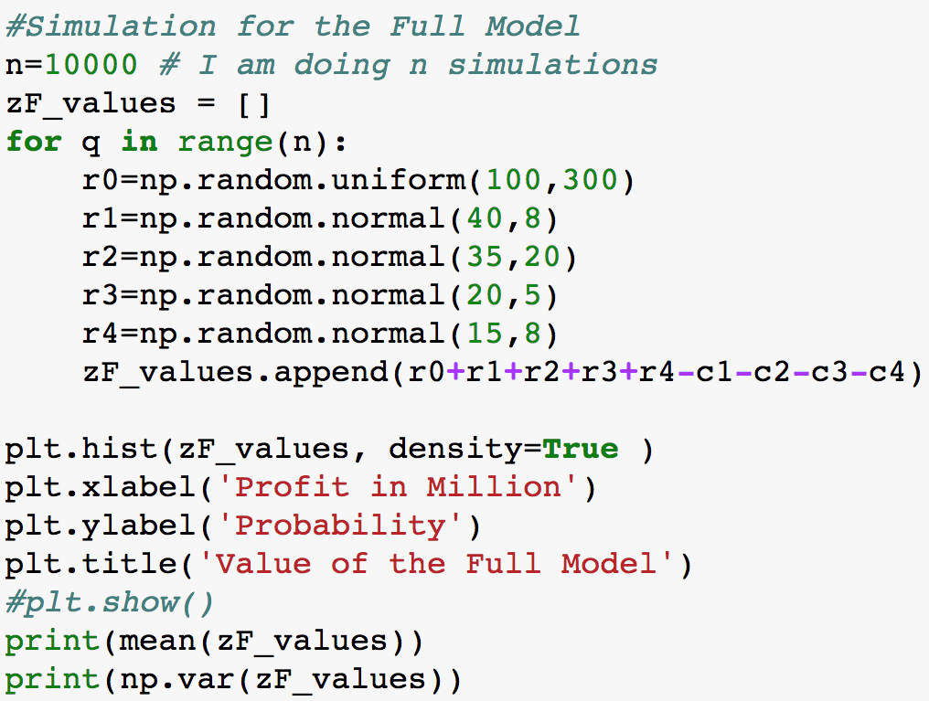
Simulations

Slide 38
Simple Choice
You have the choice between two projects
Which one would you choose?
$3 million
$2 million
0.25
0.75
A
B
0.75
0.25
$1 million
$0 million

